Slide 1

HouseKeeperens
Presented by –
Parisha Singhal- 201500463
Riya Rastogi- 201500581
Poorva Singh- 201500474
Mansi Gupta- 201500386

Slide 2

Introduction
Keeping a clean and a tidy home essential for our physical and mental well being . However, with the hectic piece of modern life, finding the time and energy to clean our house can we a daunting tasks.
Welcome to our housekeeping website, where we offer a range of professional cleaning services for hostels. The housekeeping department takes pride in keeping the hostel clean and comfortable so as to create a ‗home away from home'. Good housekeeping is considered as the backbone of accommodation sector as its main aim is to provide a clean comfortable, safe and aesthetically appealing environment.

Slide 3
Technologies used:-
01. Html
02. CSS
HyperText Markup Language (HTML) is the basic scripting language used by web browsers to render pages on the world wide web. HyperText allows a user to click a link and be redirected to a new page referenced by that link.
CSS is the language for describing the presentation of Web pages, including colors, layout, and fonts. It allows one to adapt the presentation to different types of devices, such as large screens, small screens, or printers. CSS is independent of HTML and can be used with any XML-based markup language.
HTML, or HyperText Markup, and other mults
03. JavaScript
04. PHP
05. MySQL
JavaScript (JS) is a lightweight, interpreted, or just-in-time compiled programming language with first-class functions. While it is most well-known as the scripting language for Web pages, many non-browser environments also use it, such as Node.js, Apache CouchDB and Adobe Acrobat.
PHP (recursive acronym for PHP: Hypertext Preprocessor ) is a widely-used open source general-purpose scripting language that is especially suited for web development and can be embedded into HTML.
. The database structure is organized into physical files optimized for speed. The logical data model, with objects such as data tables, views, rows, and columns, offers a flexible programming environment.

Slide 4

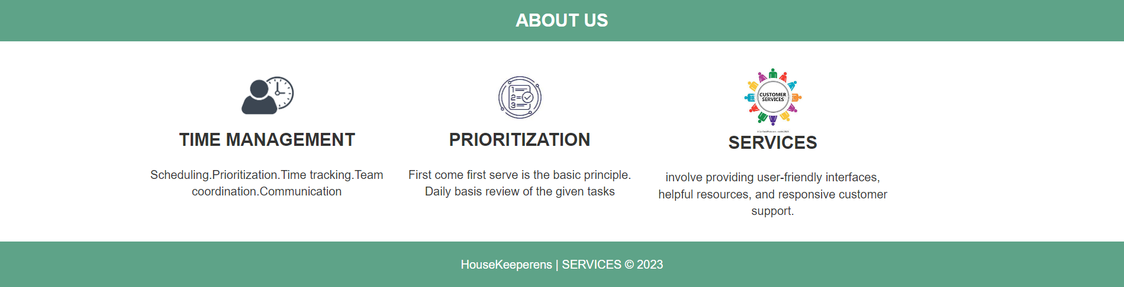
SOWFTWARE AT A GLANCE:-

Slide 5
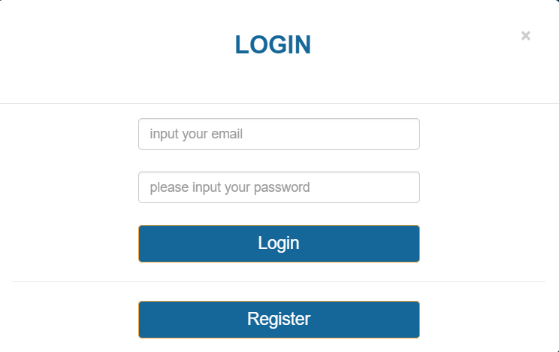
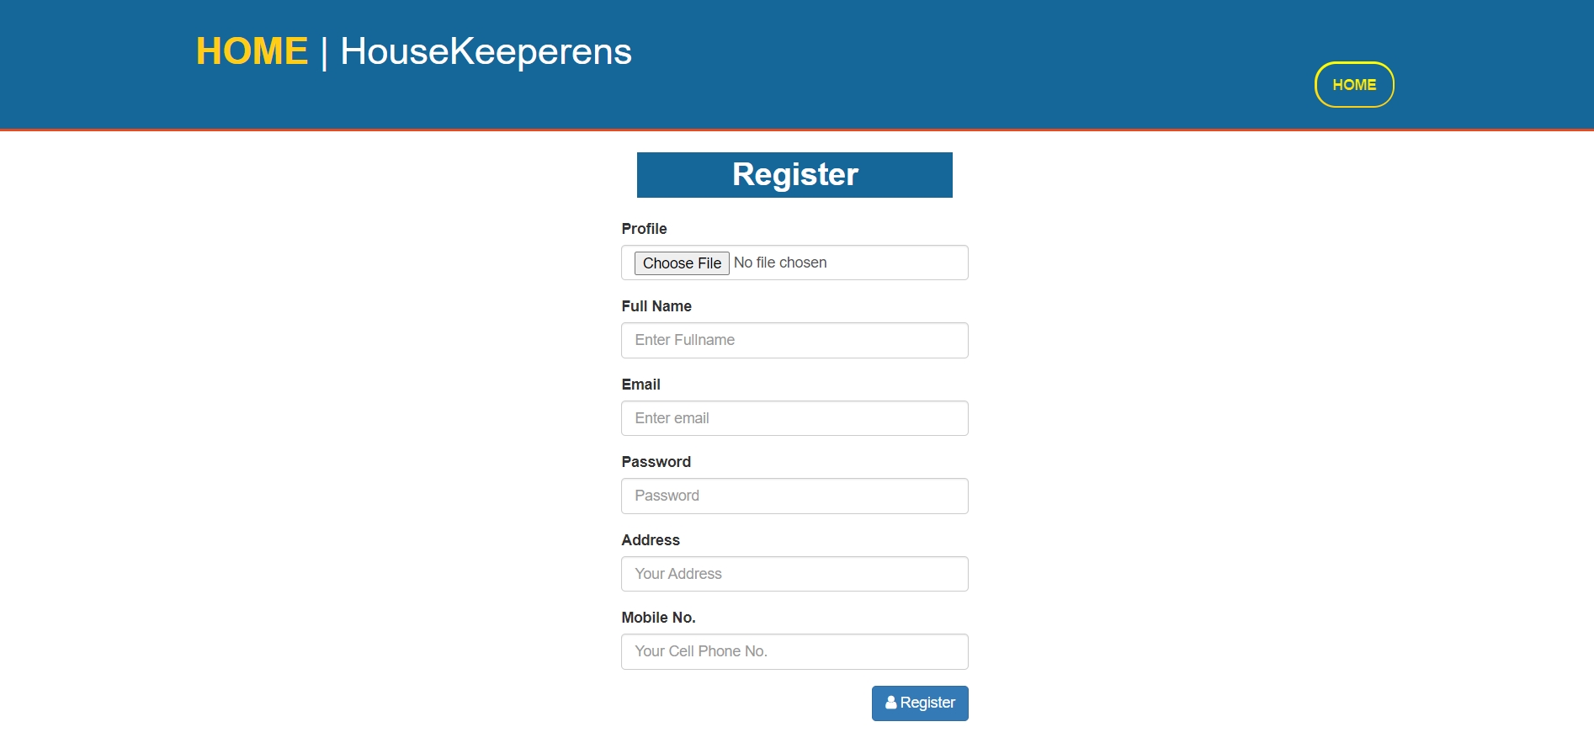
Login/sign-up:-

Slide 6
Here, user can login by using their credentials, or else a user can register itself as a new member to become a part of our family.

Slide 7
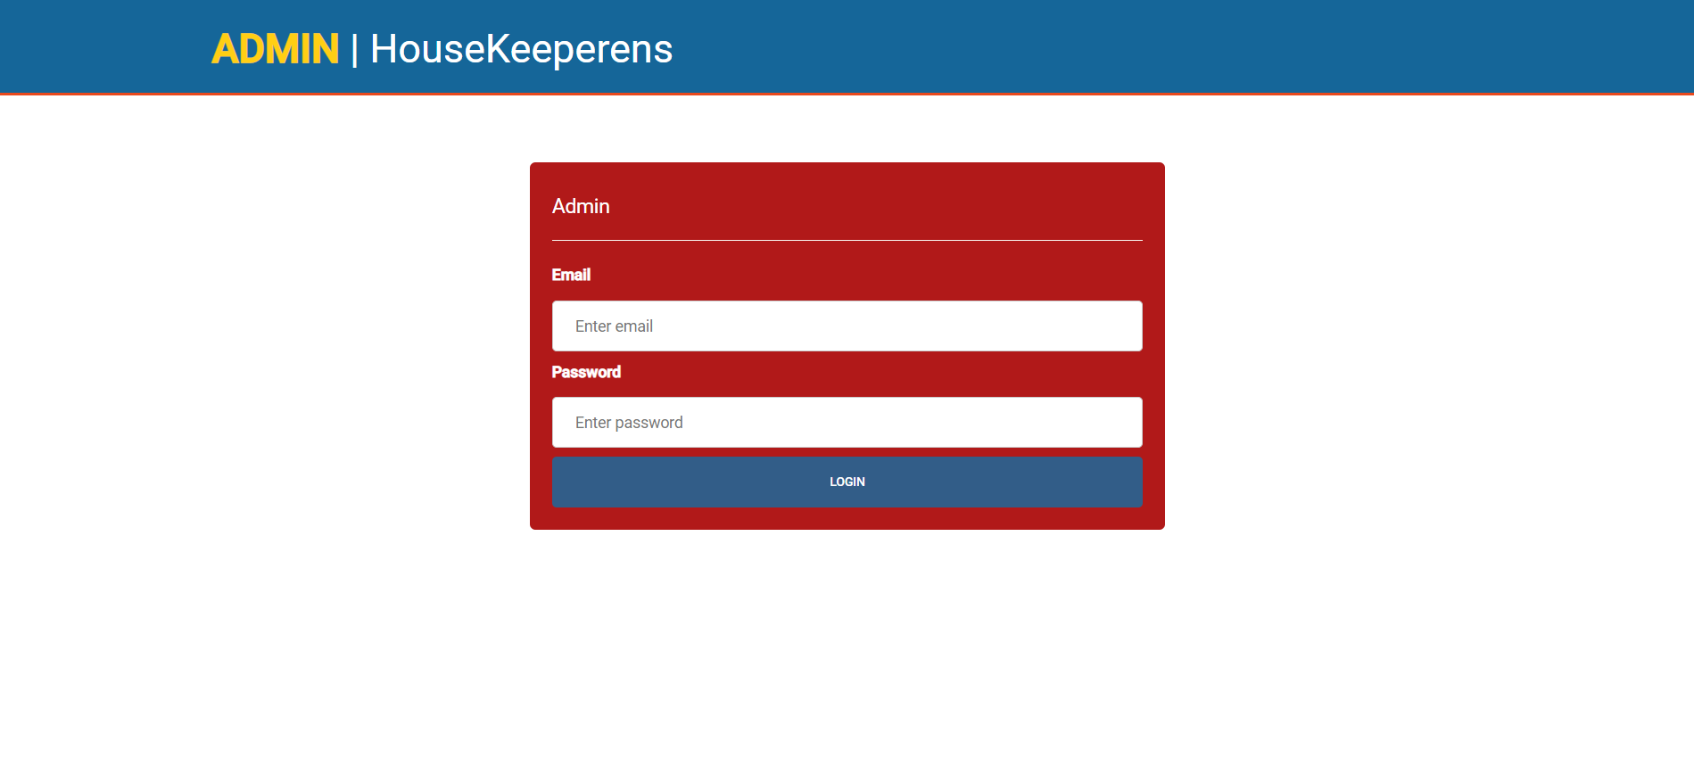
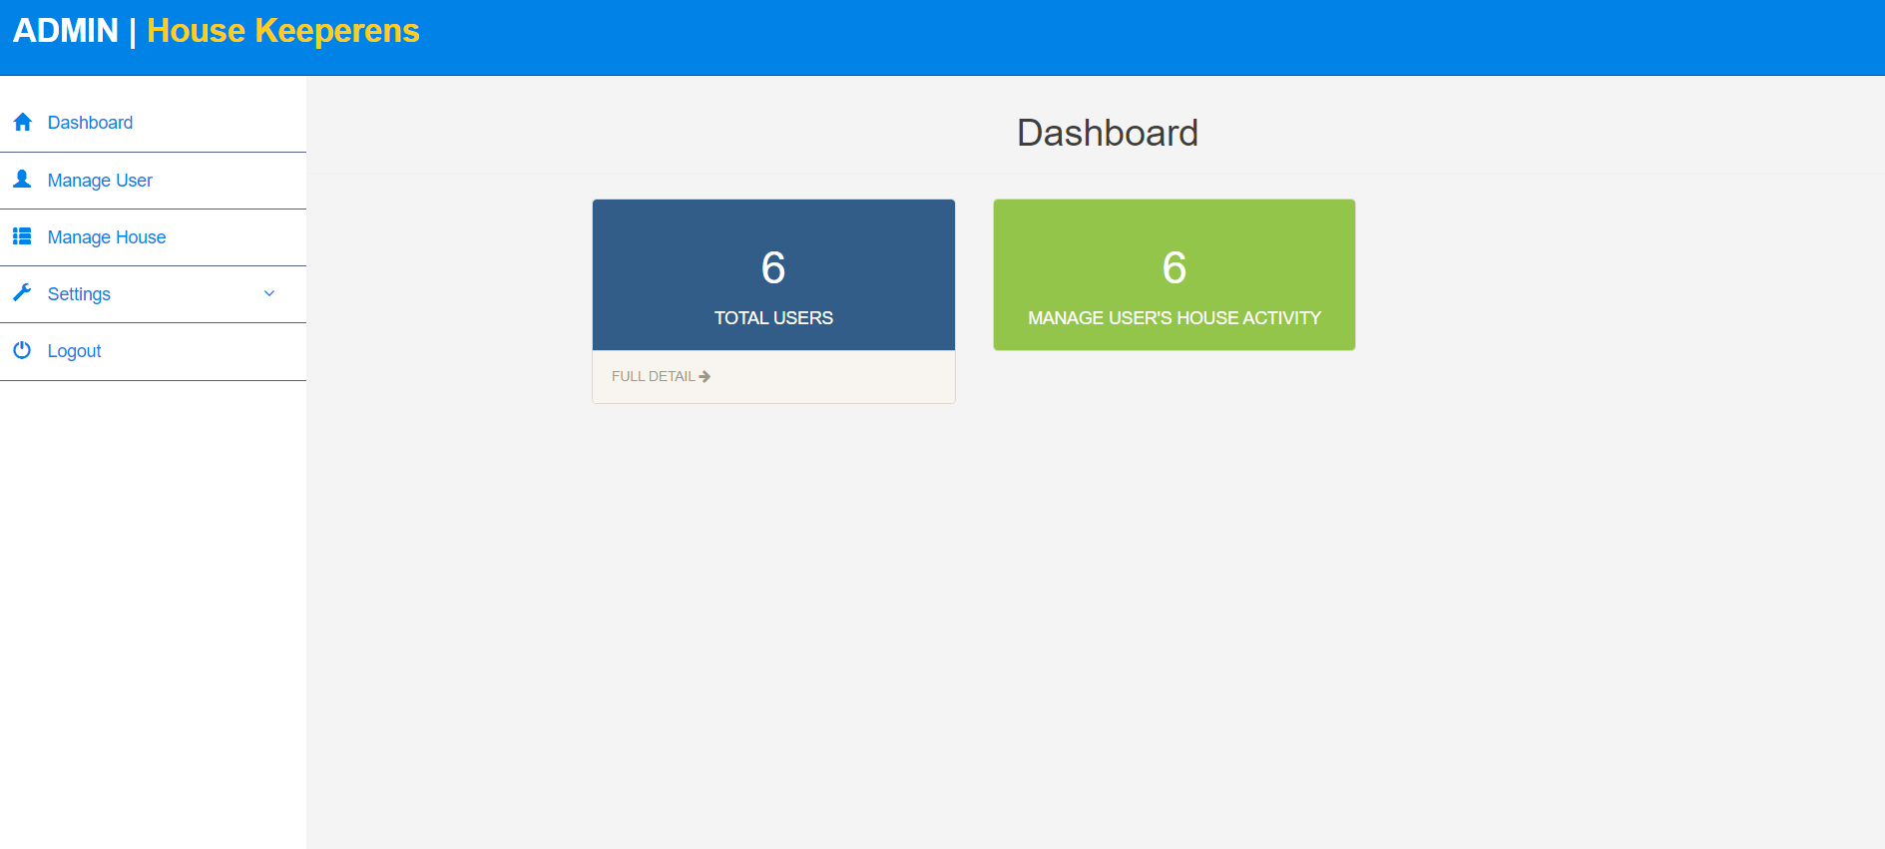
Website View|Admin
jhjh
dsdnknkdnsknk

Slide 8
The above is the view of our admin page. Admin can login with their id and password, and can manage the users and their house activities which can be seen on the dashboard.

Slide 9
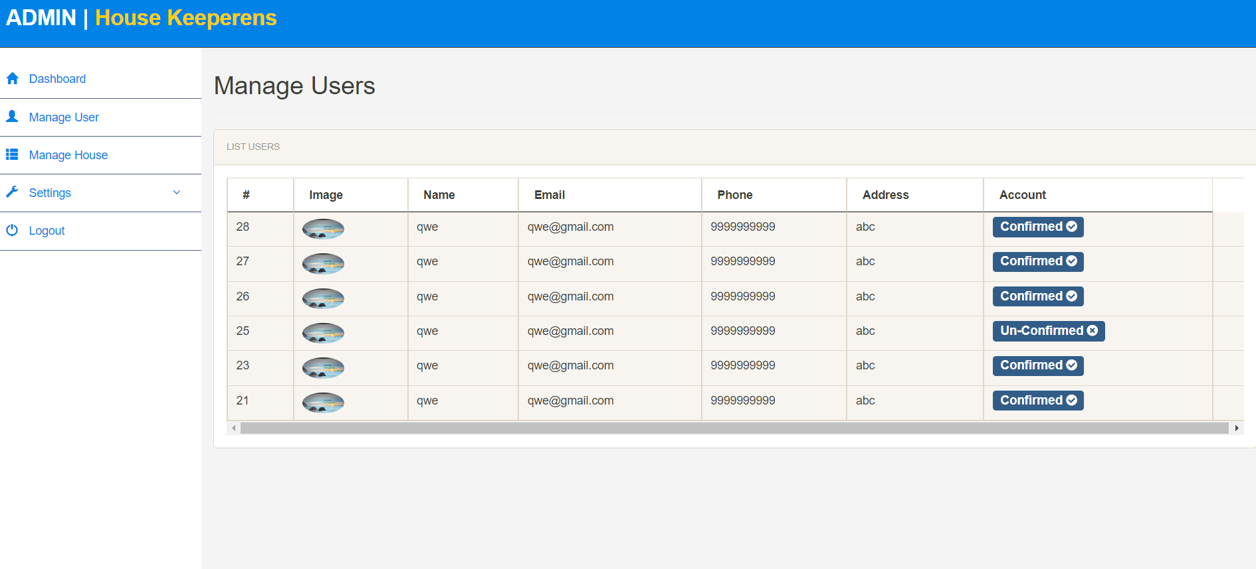
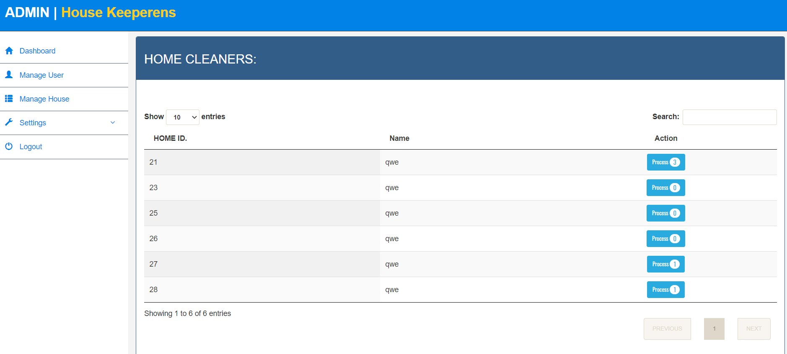
Admin- manage users manage house

Slide 10
Manage Users :- admin can get a glimpse of the details of the user and has the full authority to accept and decline the request of the user according to their convenience. Manage House :- admin can check the record of the requested tasks i.e. whether the task is completed, pending or running and see the updated status of the task requested.

Slide 11
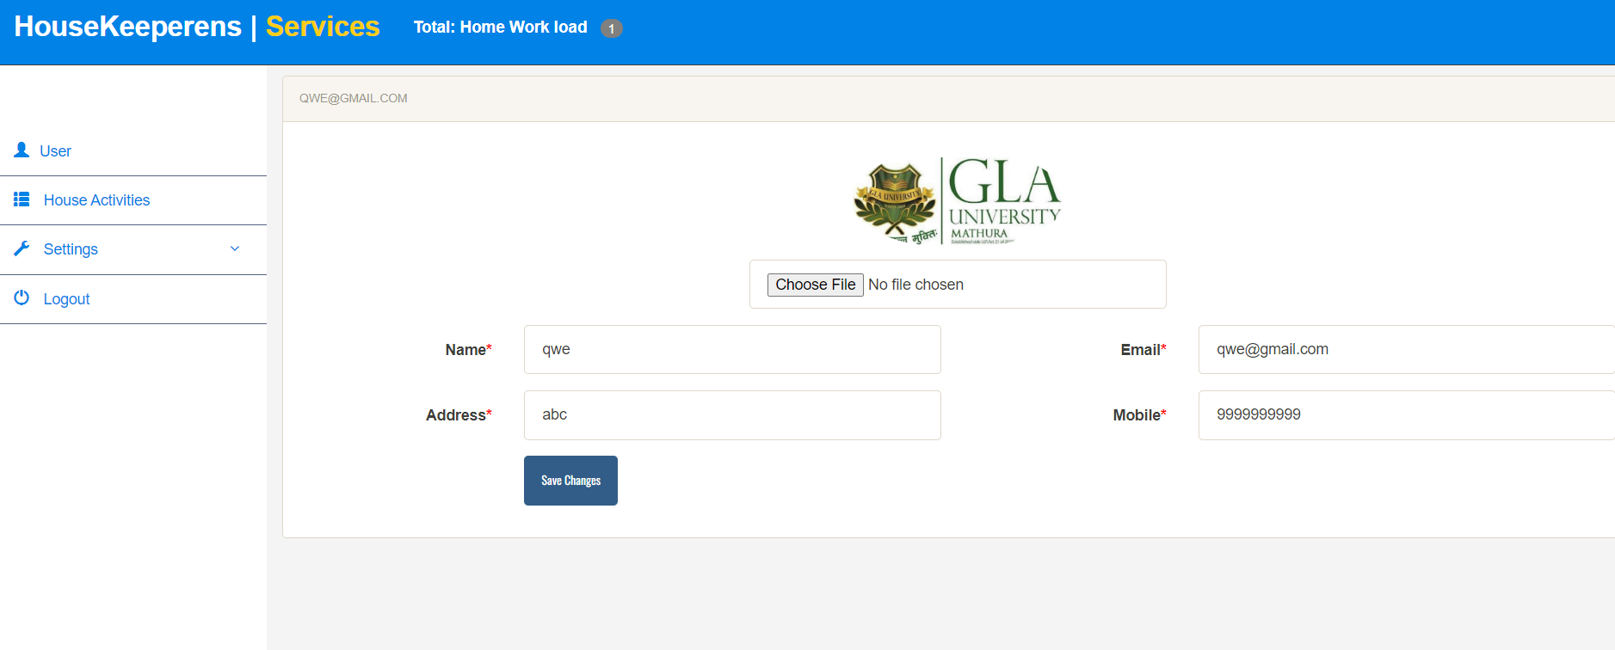
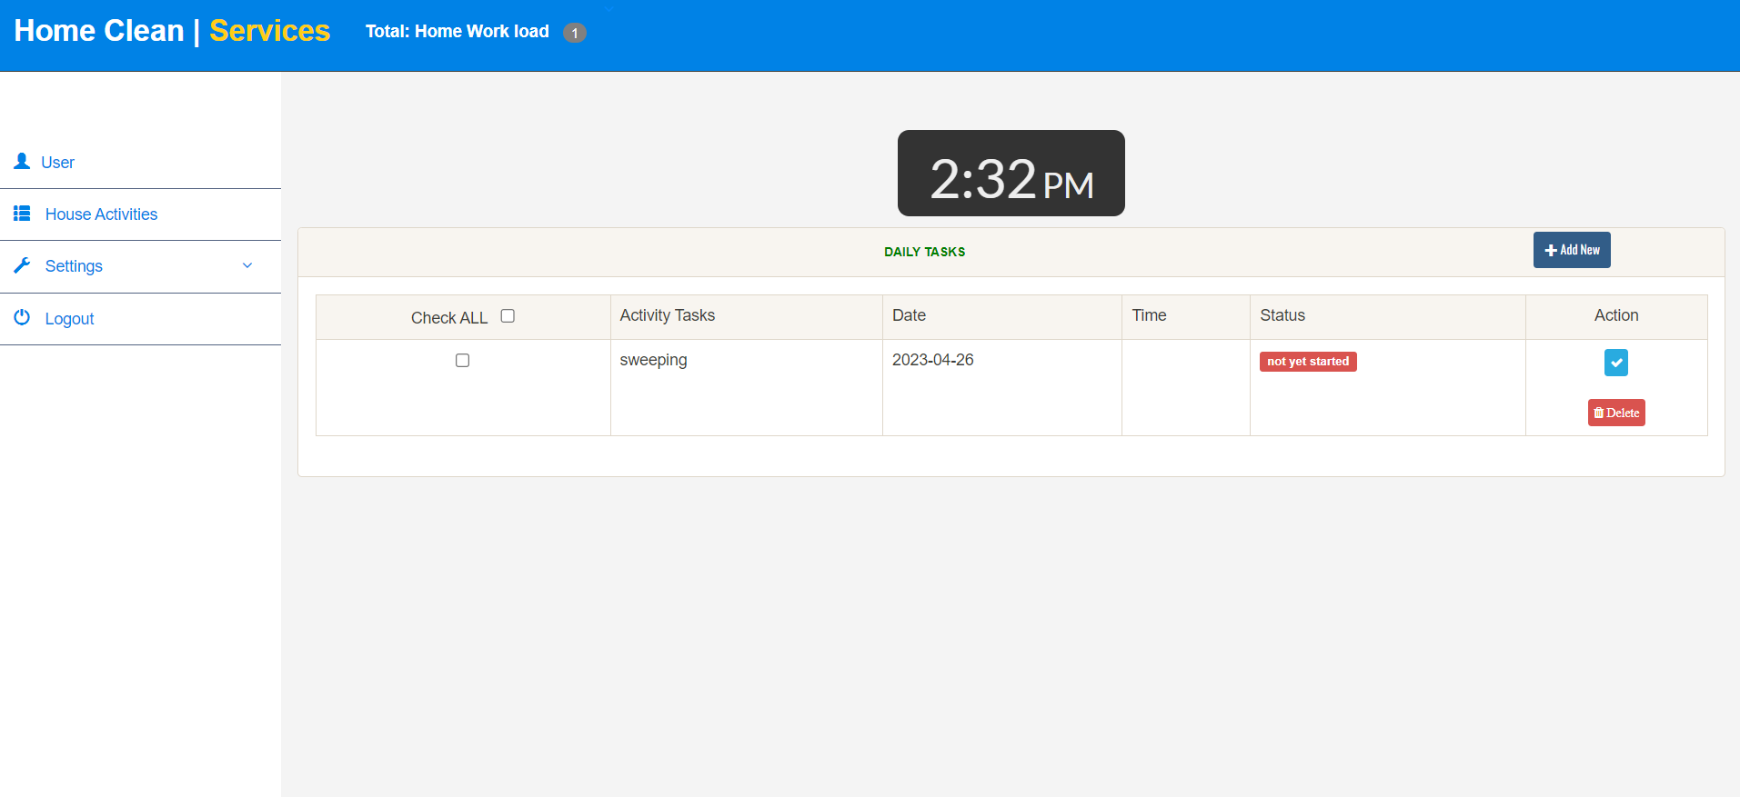
Website View|User

Slide 12
Here, user change their credentials i.e. address, image, phone number, etc. according to their comfort. Also, see the status of their requested task or further can add a new task as per their requirement.

Slide 13

Future goals:-
.
Business priorities
Expansion to new geographical locations: Once our platform gains popularity in one area, we will consider expanding it to other regions, cities, or countries.
Simplify failure reporting:Housekeeping staff are in a prime position to spot problems: controls not working,The question is: how can they report these failures?
Invest in staff training:The previous point brings us to staff training. The training you offer during onboarding is essential for the person to learn how to perform their duties and know how to comply with hygiene and safety standards.
.

Slide 14

Summary
The project aims to provide a high-quality cleaning service to customers by allowing them to add specific cleaning tasks and review the service provided. This cleaning service will cater to the needs of customers who are looking for a reliable and efficient cleaning service that can be tailored to their individual requirements. The project will use advanced technology and tools to ensure that the cleaning is done thoroughly and efficiently. Customers will be able to add specific cleaning tasks and provide feedback on the quality of service provided. The feedback will be used to improve the service and ensure that the customer is satisfied with the results. The project is designed to provide a convenient and efficient cleaning service that meets the needs of customers in a timely and cost-effective manner.

Slide 15

Thank you
.
.

